Slide 1

Title: Ramsey Numbers Analysis using Social Network Analytics
Guide: Dr. D. Hemavathi
Members:
Swastik Banerjee [RA1711008010239]

Slide 2
Introduction
In this Combinatorial Graph Theory and Social Media Analytics research project, we aim to analyze already existing anonymous graph networks taken from social media datas like Facebook and find out how much they tally with Ramsey’s theorem.

Slide 3
Objective: What is Ramsey’s Theorem?
`
In combinatorics, Ramsey Theorem states that one will always find monochromatic cliques when the edges are coloured in a sufficiently large complete graph. For example, say we have two positive integers r and s. Ramsey-theorem guarantees that there has to be one least positive integer for which every blue-red (in the case of two-coloring) edge coloring of the complete graph of R(r,s) vertices contains a blue r-clique or a red s-clique.

Slide 4
Purpose of project
In our research analysis project, we will survey on social media graphs taken from Facebook users of MIT and see how much the results are close to the Ramsey Theorem in practice.
That is, Ramsey’s theorem gives a minimum number of edges to guarantee the existence of a monochromatic clique of either red color or blue color.
In our experiment, we have designed red colored edge as knowing each other in Facebook, and blue colored edge as not-knowing each other in Facebook, where the complete graph is formed by vertices where each vertex is an user of Facebook.

Slide 5
Existing System
A social friendship network extracted from Facebook consisting of people (nodes) with edges representing friendship ties was used from MIT was used in our research analysis.
A complete graph consisting of undirected edges were created using MIT Facebook Analytics.
As stated above, the data had 6.4K nodes, where a connected to b meant that node a was connected to node b in Facebook. These edges were coloured red. The nodes that did not know each other were also joined using blue edges to make it a complete graph.
The above manipulation was done using the software Mathematica licensed under Wolfram Research, Inc, a very good tool to do these mathematical manipulations of graphs, etc.

Slide 6
Limitations of existing models: Currently Known Values of Ramsey Numbers -
R(3, 3) = 6 as previously mentioned. Ramsey for 4,2 and Ramsey for any s,2 is always equal to s for any s. It is extremely simple to prove: As a counterexample, let us take a graph with s1 nodes and the edges when all coloured red proves that Ramsey of s,2 is always equal to s. A s-node red subgraph exists in the colouring of all edges coloured red, and a 2-node blue subgraph exists in all other colourings of a graph on s nodes (that is, a pair of nodes connected with a blue edge.)
The values of Ramsey of 4,3 can be calculated using values of Ramsey for 4,2 and 3,3. Similarly, it is easy to deduce the values of Ramsey of 4,4 for 2-coloruing. Various colourings of graph were constructed to find lower bounds of these numbers, and finally Ramsey of 4,4 has been deduced to be 18.
The exact values of Ramsey of 5,5 is unknown, but it known to lie between 43 and 48. The exact value of Ramsey of 4,5 is however known to be exactly 25.

Slide 7
Literature Survey
Some related works are:
▷“Small Ramsey Numbers
Stanisław Radziszowski
DS1: Jan 15, 2021
2011-08-22 ”
▷“Ramsey Theory Applications
Vera Rosta
DS13: Dec 7, 2004
2004-12-07 ”
▷“Ramsey Numbers of Ordered Graphs
Martin Balko, Josef Cibulka, Karel Král, Jan Kynčl
P1.16
2020-01-10 ”
▷“Constructive Lower Bounds on Classical Multicolor Ramsey Numbers
“Xu Xiaodong, Xie Zheng, Geoffrey Exoo, Stanisław P. Radziszowski
R35
2004-06-04 ”

Slide 8
Proposed System Analysis
A complete graph consisting of undirected edges were created using MIT Facebook Analytics.
As stated above, the data had 6.4K nodes, where a connected to b meant that node a was connected to node b in Facebook. These edges were coloured red. The nodes that did not know each other were also joined using blue edges to make it a complete graph.
The above manipulation was done using the software Mathematica licensed under Wolfram Research, Inc, a very good tool to do these mathematical manipulations of graphs, etc.

Slide 9
Project Plan/Methodology
Collect data from social media analytics website and form a complete two-coloured graph using social media networks.
Choose a number N and run the experiment a large number of times, say 100, and note in each case the min. no. of nodes needed to find a clique of N edges
We get a distribution of the sample modes. By seeing the histogram, determine the underlying distribution.
Find the confidence interval of the mean of the distribution using R.
This interval will contain the number of nodes needed for N-edged clique with highest probability.
7

Slide 10
The Dataset
The dataset that we are trying for this experiment is being gathered from various social media analytics website like http://networkrepository.com/socfb.php and https://snap.stanford.edu/data/egonets-Facebook.html .
A constant research for better and more appropriate data is still being done by the person involved with this project.
8

Slide 11
Impact of our method
• Using our experiments, we can move one step forward into conjecturing the exact values of R(6,6), R(7,7) etc.
• For R(r, s) with r, s > 5, only weak bounds are available. Lower bounds for R(6, 6) and R(8, 8) have not been improved since 1965 and 1972, respectively. Using our research experiments, we can improve the lower bounds.

Slide 12
Tools Used
Mathematica software
Stanford Dataset Social Network Analytics

Slide 13
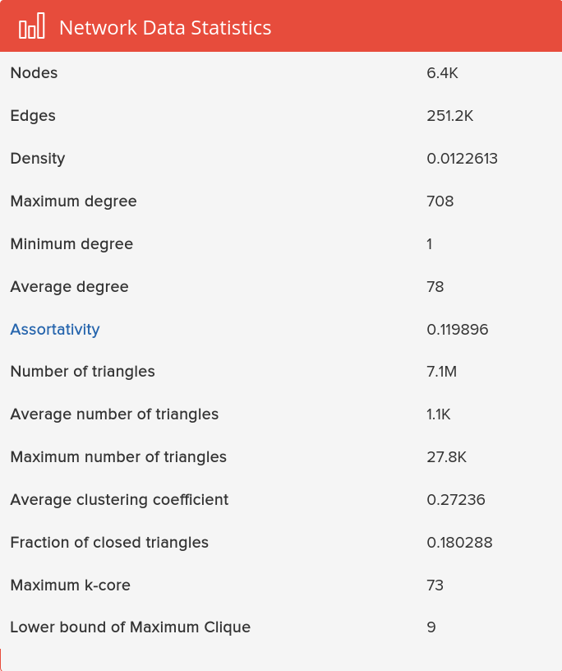
Dataset

Slide 14
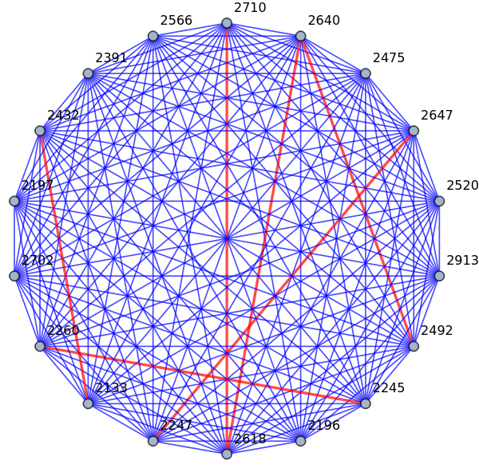
Input

Slide 15
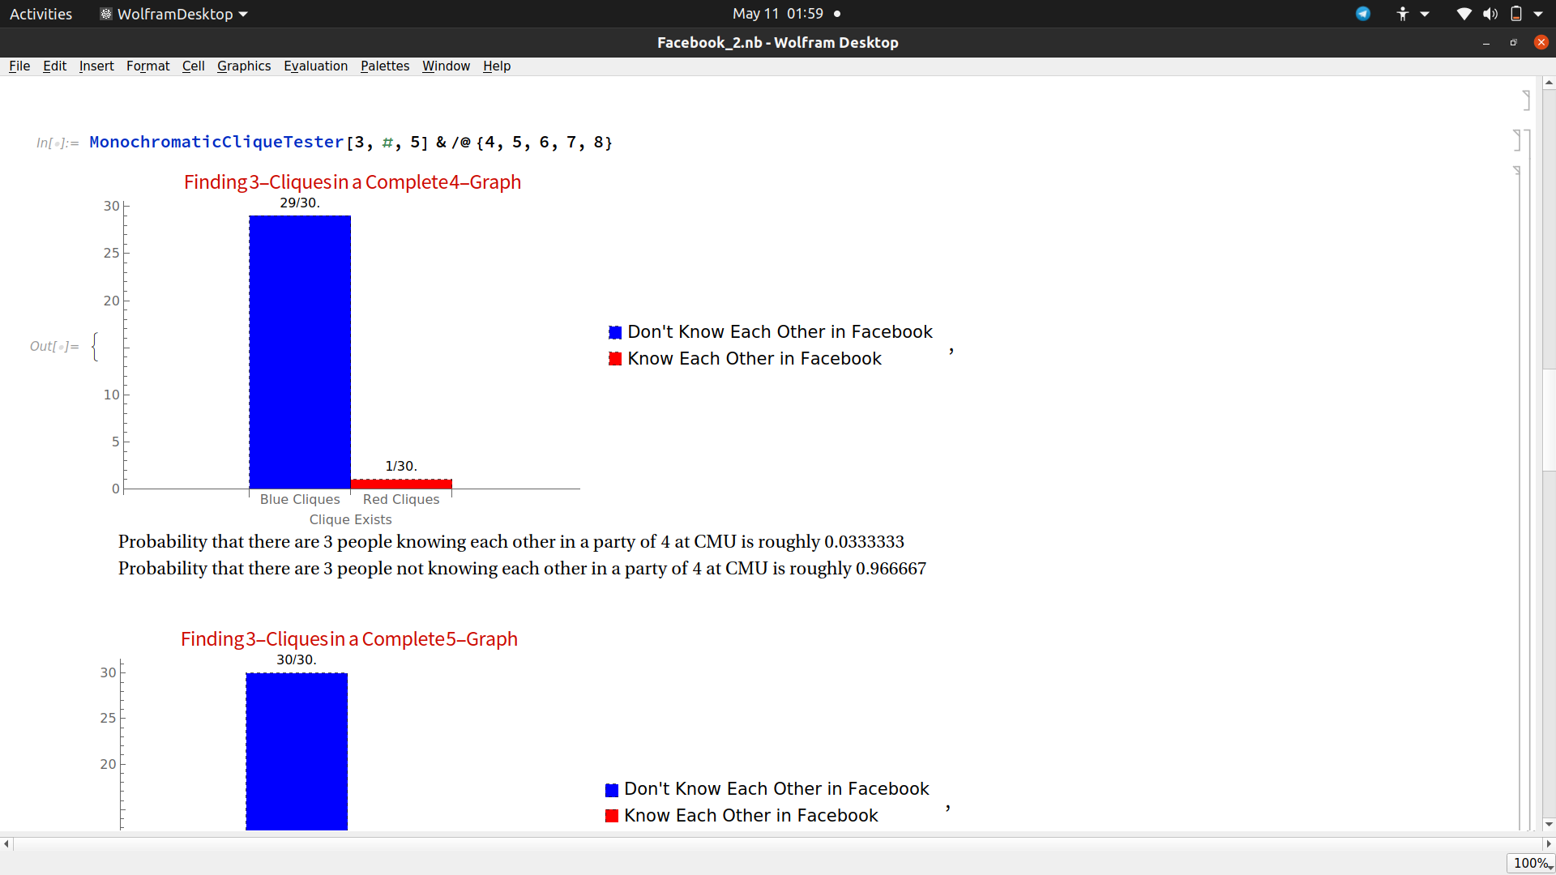
Output

Slide 16
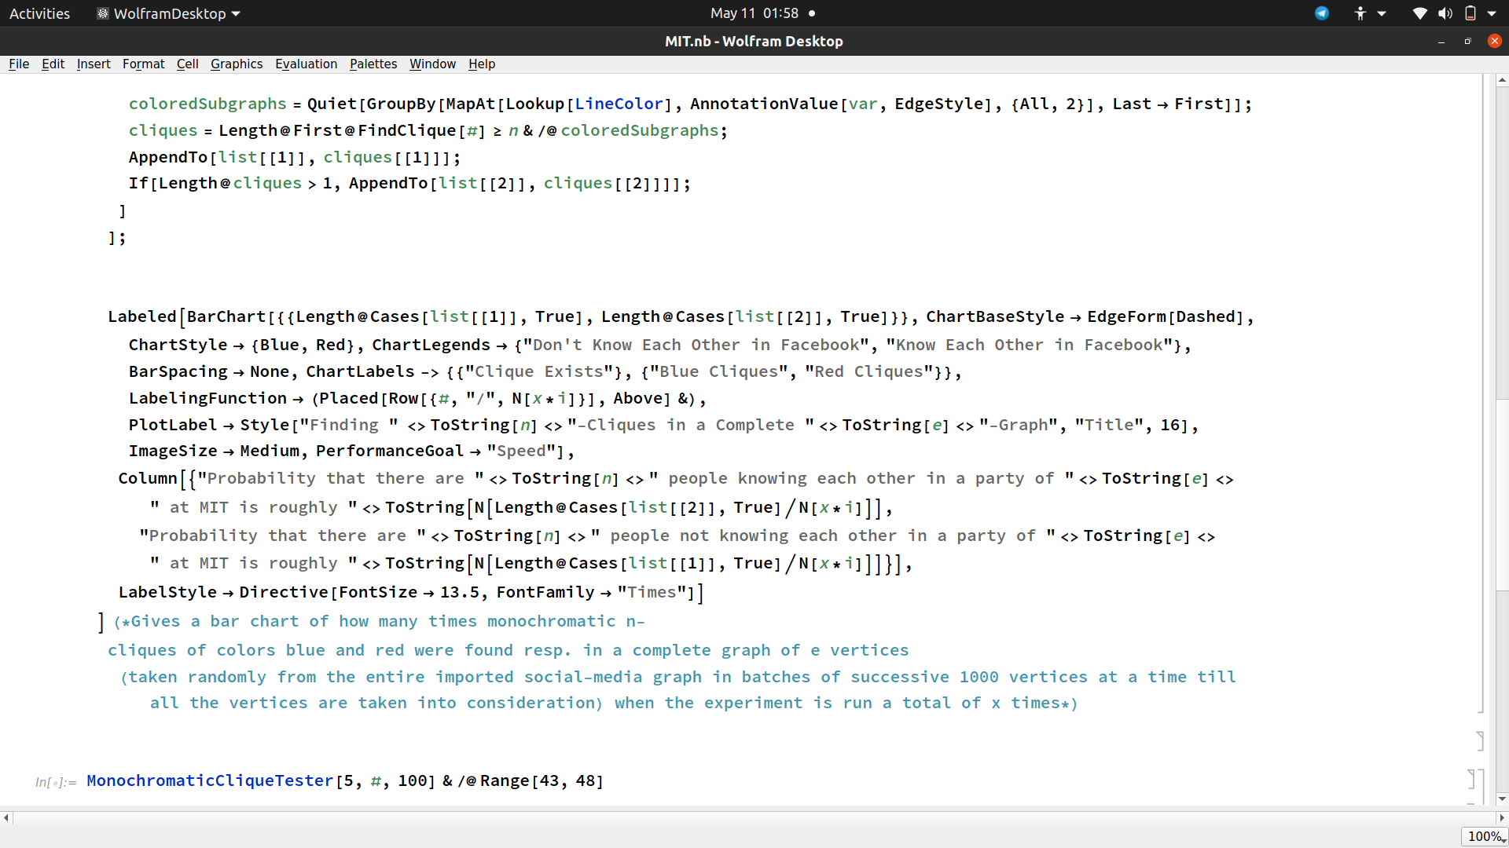
Code Sample

Slide 17
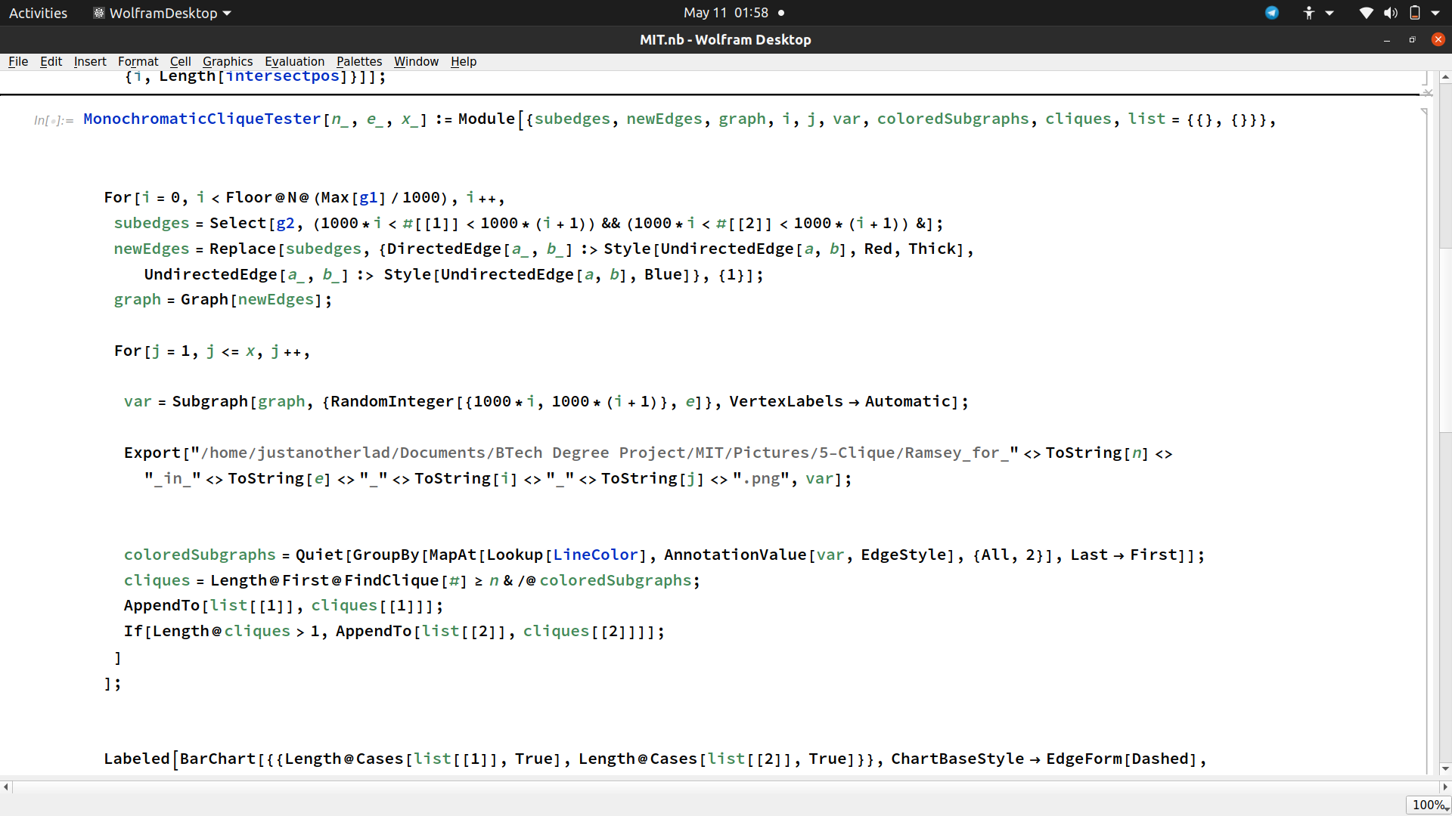

Slide 18
Conclusion
Our experiment determines that practically, in the famous party problem, the probability of people not knowing each other is far more than people knowing each other, althought theoretically we assume both are equally likely.

Slide 19
References
Bohman, Tom; Keevash, Peter (2010), "The early evolution of the H-free process", Invent. Math., 181 (2): 291–336, arXiv:0908.0429, Bibcode:2010InMat.181..291B, doi:10.1007/s00222-010-0247-x
Brualdi, Richard A. (2010), Introductory Combinatorics (5th ed.), Prentice-Hall, pp. 77–82, ISBN
Conlon, David (2009), "A new upper bound for diagonal Ramsey numbers", Annals of Mathematics, 170 (2): 941–960, arXiv:math/0607788v1, doi:10.4007/annals.2009.170.941, MR 2552114.
Erdős, Paul (1947), "Some remarks on the theory of graphs", Bull. Amer. Math. Soc., 53 (4): 292–294, doi:10.1090/S0002-9904-1947-08785-1.
Erdős, P.; Moser, L. (1964), "On the representation of directed graphs as unions of orderings" (PDF), A Magyar Tudományos Akadémia, Matematikai Kutató Intézetének Közleményei, 9: 125–132, MR 0168494

Slide 20
Exoo, G. (1989), "A lower bound for R(5,5)", Journal of Graph Theory, 13: 97–98, doi:10.1002/jgt.3190130113.
Graham, R.; Rothschild, B.; Spencer, J. H. (1990), Ramsey Theory, New York: John Wiley and Sons.
Gross, Jonathan L. (2008), Combinatorial Methods with Computer Applications, CRC Press, p. 458, ISBN
Harary, Frank (1972), Graph Theory, Addison-Wesley, pp. 16–17, ISBN
Ramsey, F. P. (1930), "On a problem of formal logic", Proceedings of the London Mathematical Society, 30: 264–286, doi:10.1112/plms/s2-30.1.264.
Spencer, J. (1975), "Ramsey's theorem – a new lower bound", J. Combin. Theory Ser. A, 18: 108–115, doi:10.1016/0097-3165(75)90071-0.

Slide 21
FUTURE WORK :
1. This experiment can be used to determine lower bounds for larger Ramsey Numbers
2. Similar Social Media Analysis can be done to obtain results in the fields of Combinatorics or Graph Theory.

